Slide 1
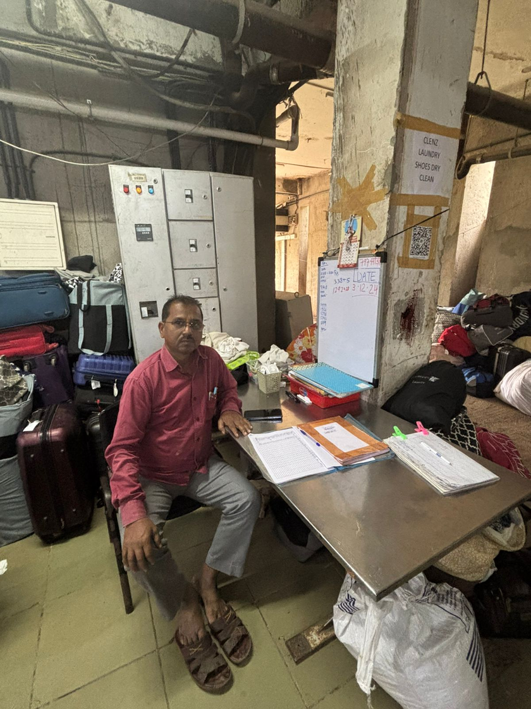
FLAME
Laundry
Home
Free Laundry
Paid Laundry
Laundry Presentation
OPSM307 -Laundry Model That Makes Your Life Easier
BY ADVIKA, FREYA, KASHISH, SNEH, VARSHA, PIYUSH

Slide 2
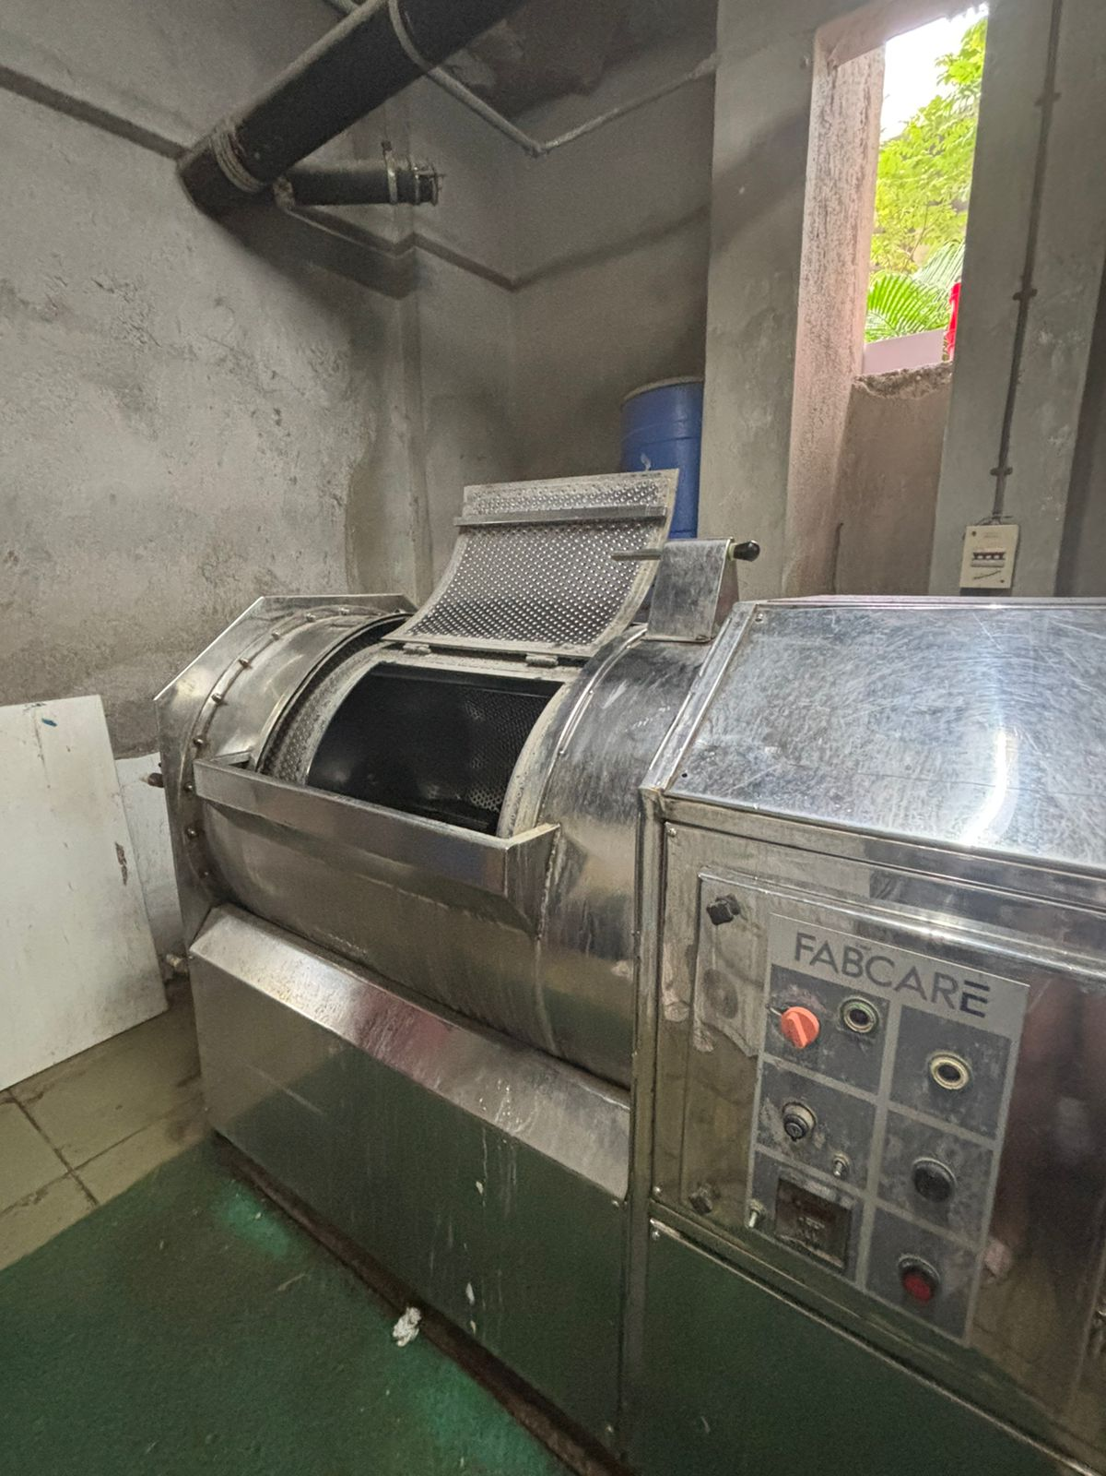


FLAME
Laundry
Home
Free Laundry
Paid Laundry
About FLAME Laundry System
Flame offers two types of laundry services. A paid one where you pay per load or free one which is inclusive of the fees.
Our Solving Approach
Types - Paid & Free
We initially tried using LPP but we were trying to solve multiple goals and have different approaches.
Hence we decided to go ahead with Goal Programming instead!
Flame offers two types of laundry services. A paid one where you pay per load or free one which is inclusive of the fees.
Our Mission/ Goal
Finding optimal number of washing machines and workers that
a)Meet demand
b)Minimize cost
c)Minimize spillover

Slide 3
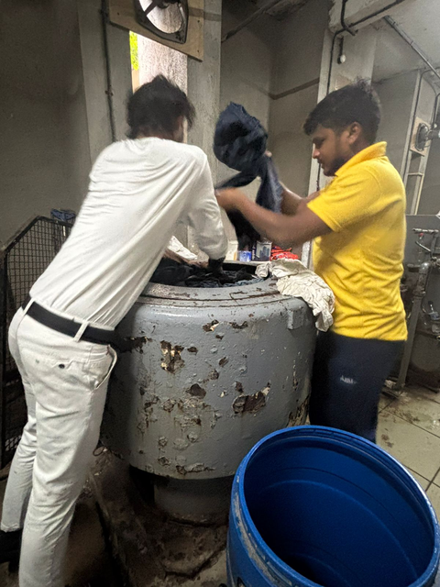
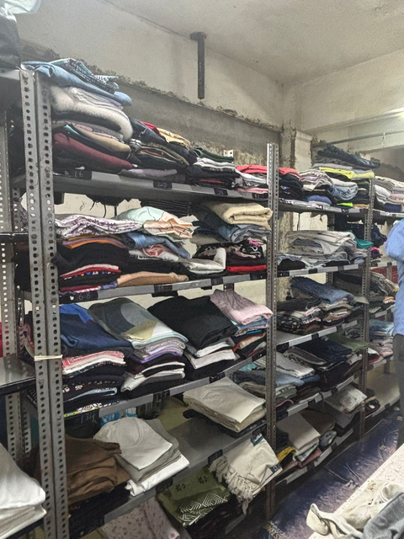
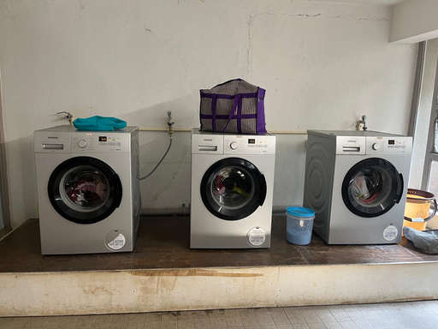
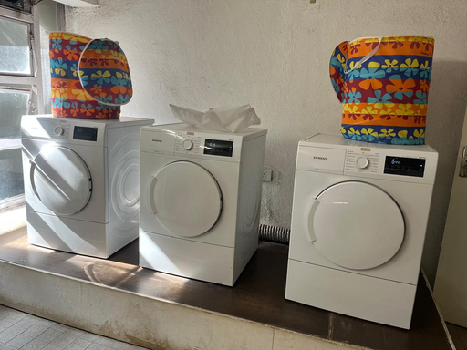
FLAME
Laundry
Home
Free Laundry
Paid Laundry
Services Provided
Free Laundry Service
The free laundry washes, dries and irons the clothes. The machines which are utilized by them are washing machines, hydro spinner, dryers and irons. Hence the clothes are returned over a period of 2 days.
40 free clothes per month
Paid Laundry Service
The paid laundry only washes and dries your clothes. The machines which are utilized by them are washing machines and dryers. They usually return the clothes on the same day or within 1 day.
150/- approx 12 clothes per load

Slide 4
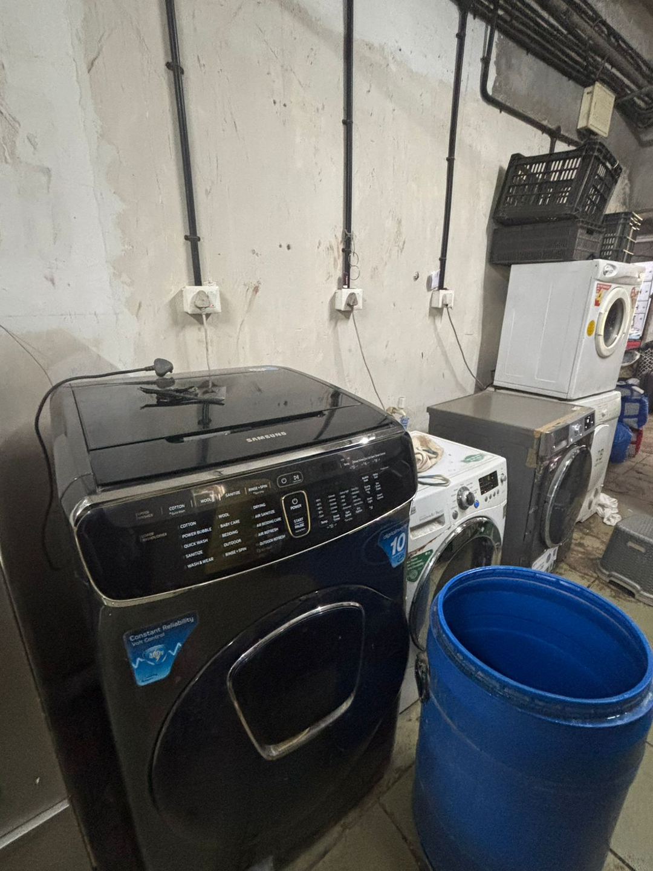
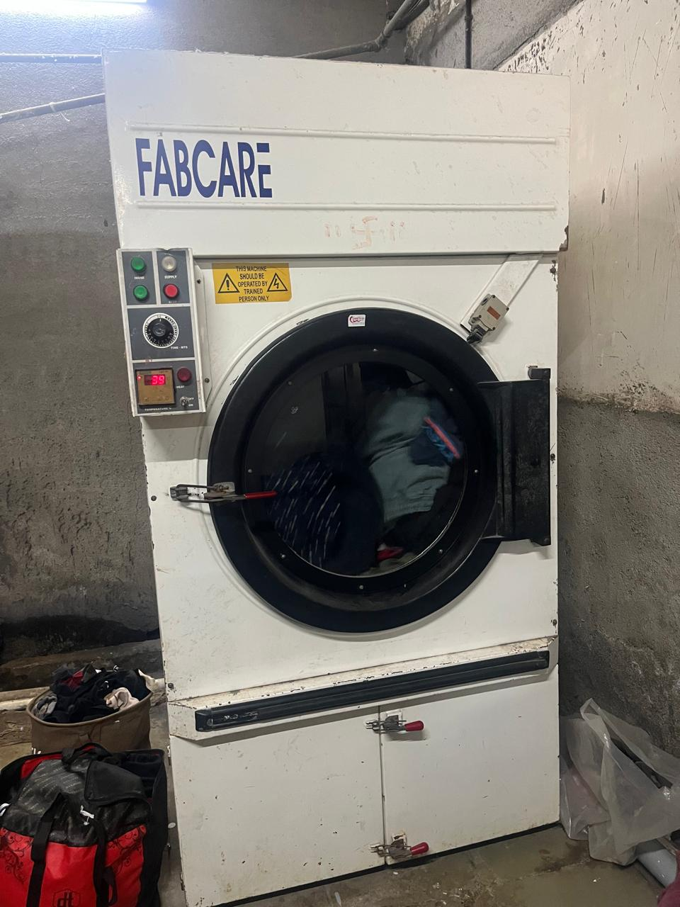



FLAME
Laundry
Home
Free Laundry
Paid Laundry
c
c
Assumptions to keep in mind!
The number of washing machines and dryers, as well as their capacity, are identical
80% of the laundry consists of colored clothes, while 20% is white
All the formulation is based on data available and collected by us

Slide 5
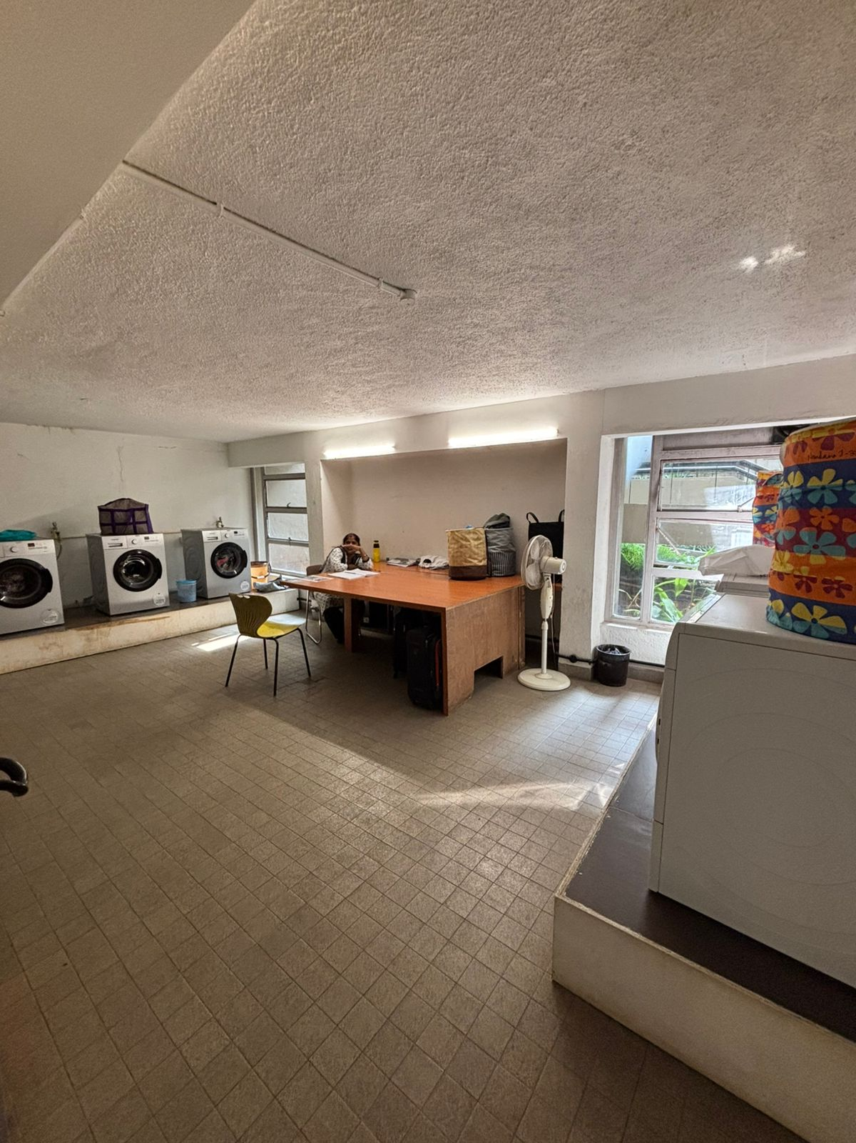
FLAME
Laundry
Paid Laundry
O, P, Q, R, JP & VKS
blocks

Slide 6
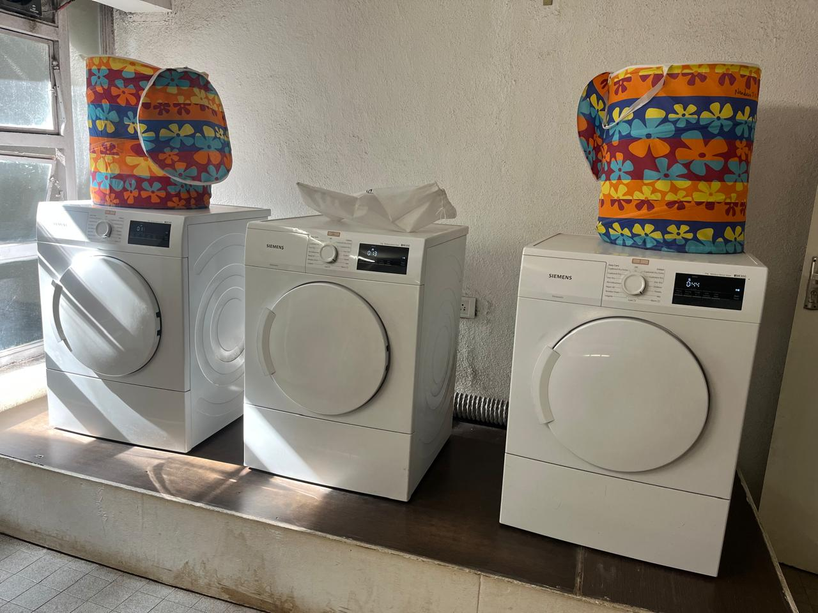
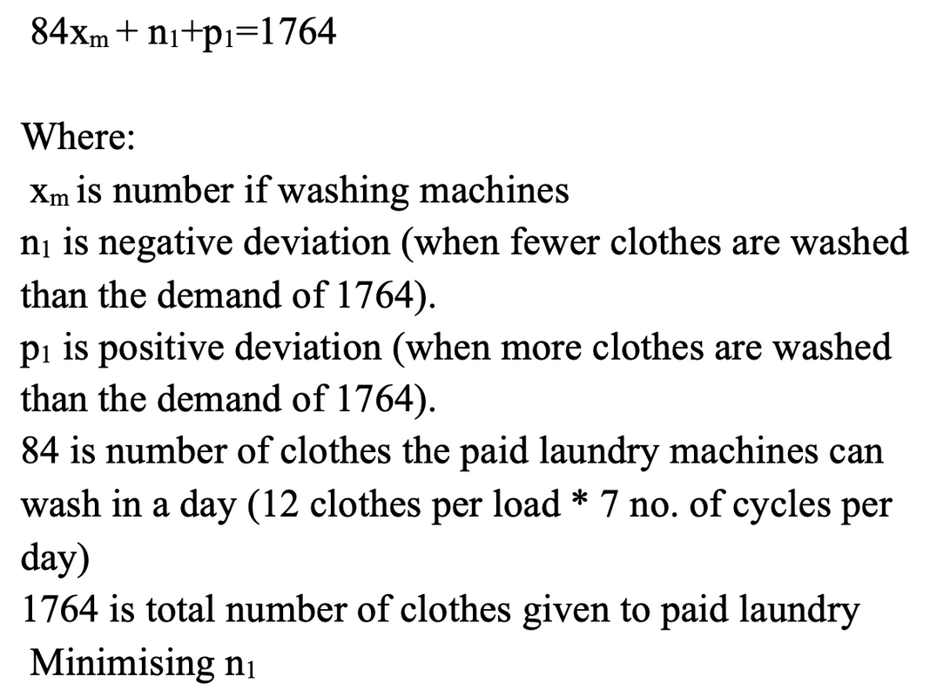
Home
Free Laundry
Paid Laundry
FLAME
Laundry
Meeting Demand
Demand Constraint

Slide 7
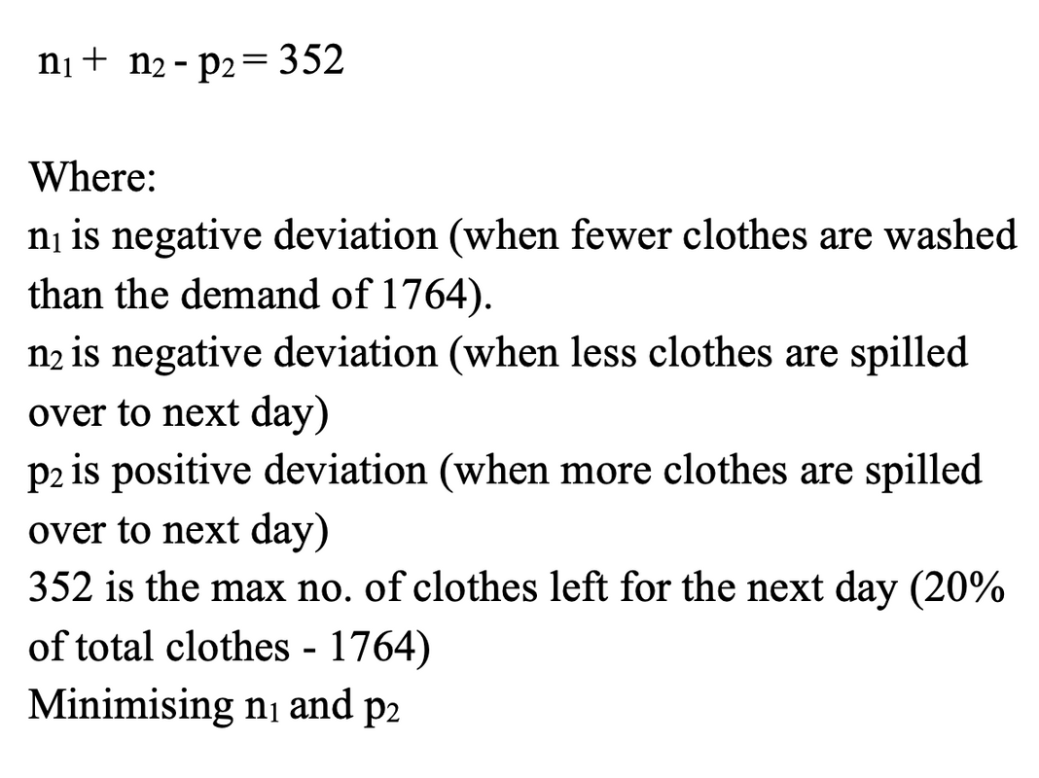

Home
Free Laundry
Paid Laundry
FLAME
Laundry
Spillover Allowance Constraint
Meeting Demand

Slide 8
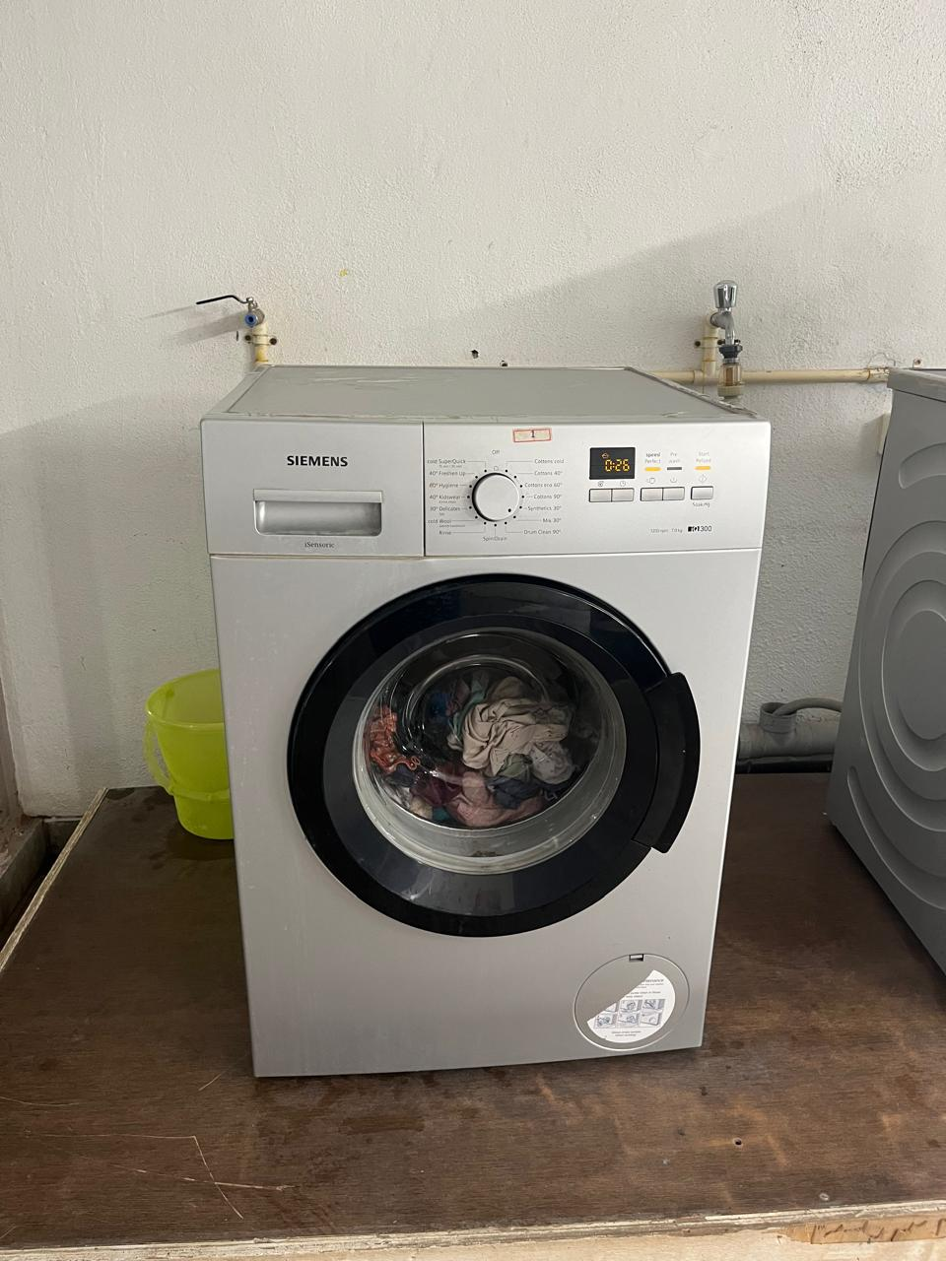
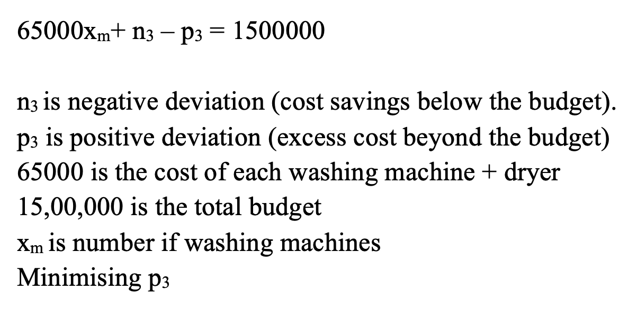
Home
Free Laundry
Paid Laundry
FLAME
Laundry
Cost Constraint
Meeting Demand

Slide 9
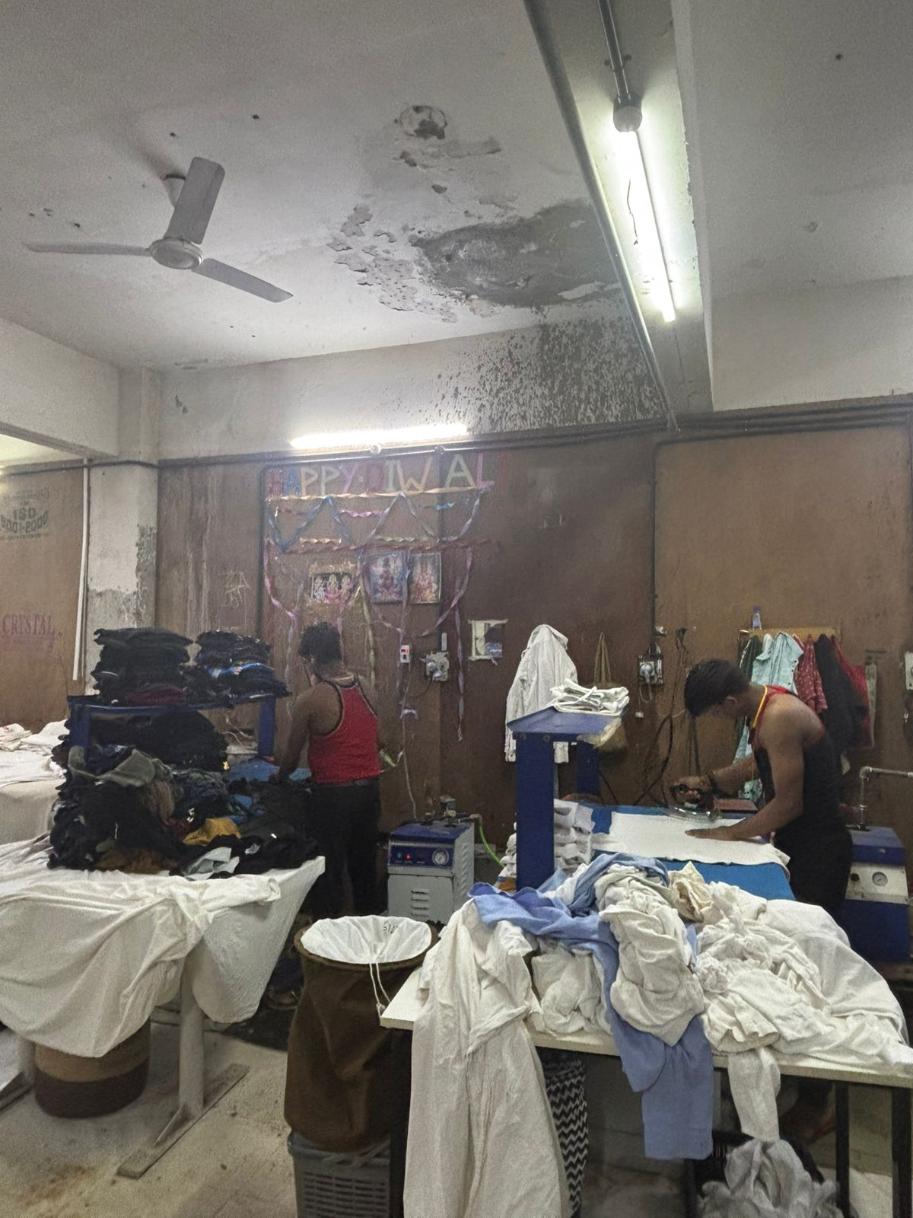
FLAME
Laundry
Free Laundry

Slide 10
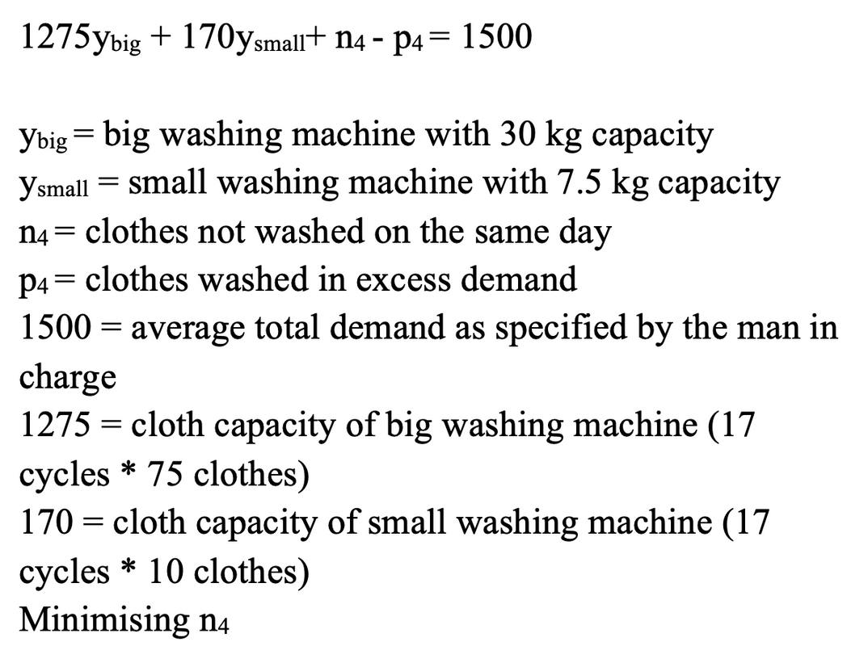
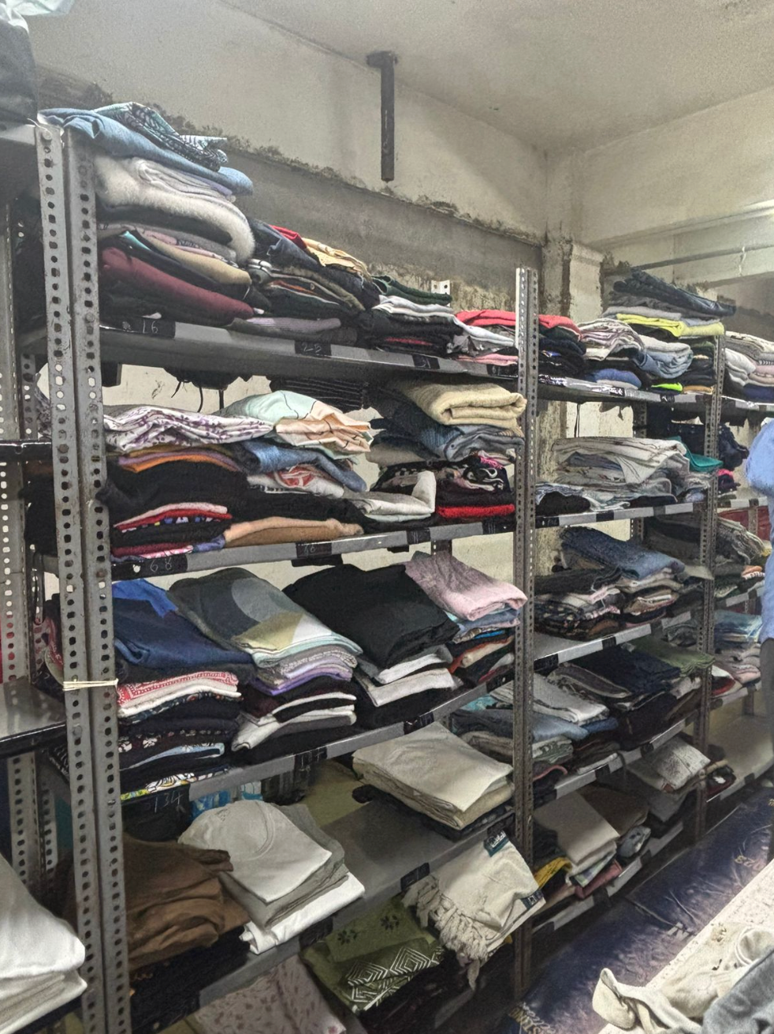
Home
Free Laundry
Paid Laundry
FLAME
Laundry
Meeting Demand for Washing
Meeting Demand

Slide 11
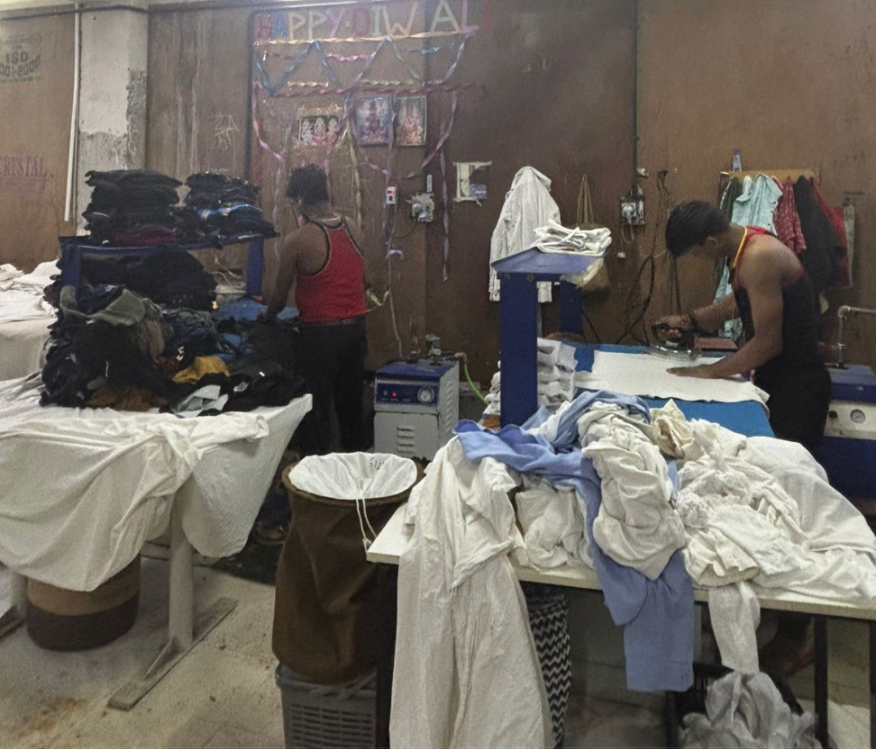
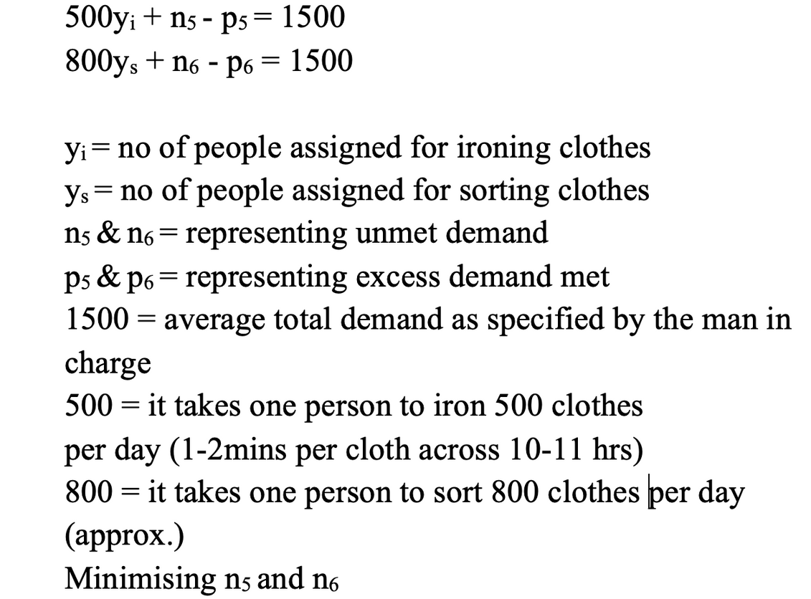
Home
Free Laundry
Paid Laundry
FLAME
Laundry
Meeting Demand for
Ironing & Sorting
Meeting Demand

Slide 12
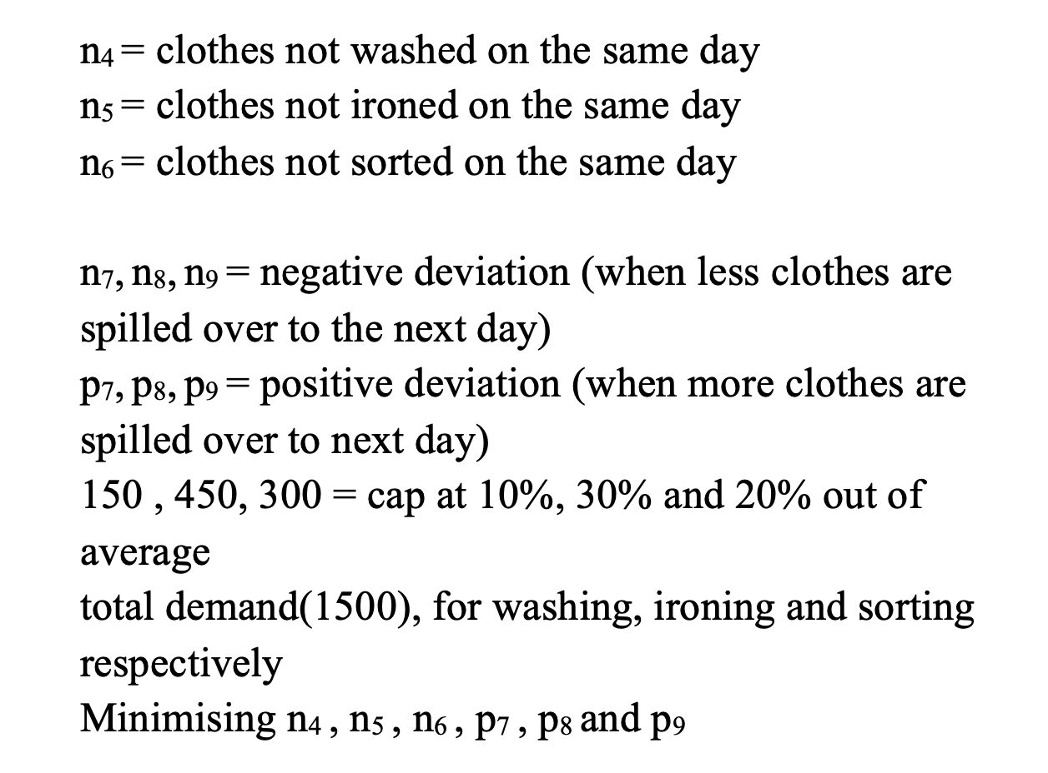
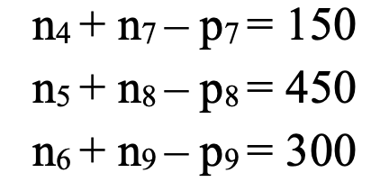
Home
Free Laundry
Paid Laundry
FLAME
Laundry
Spillover Allowance Constraint

Slide 13
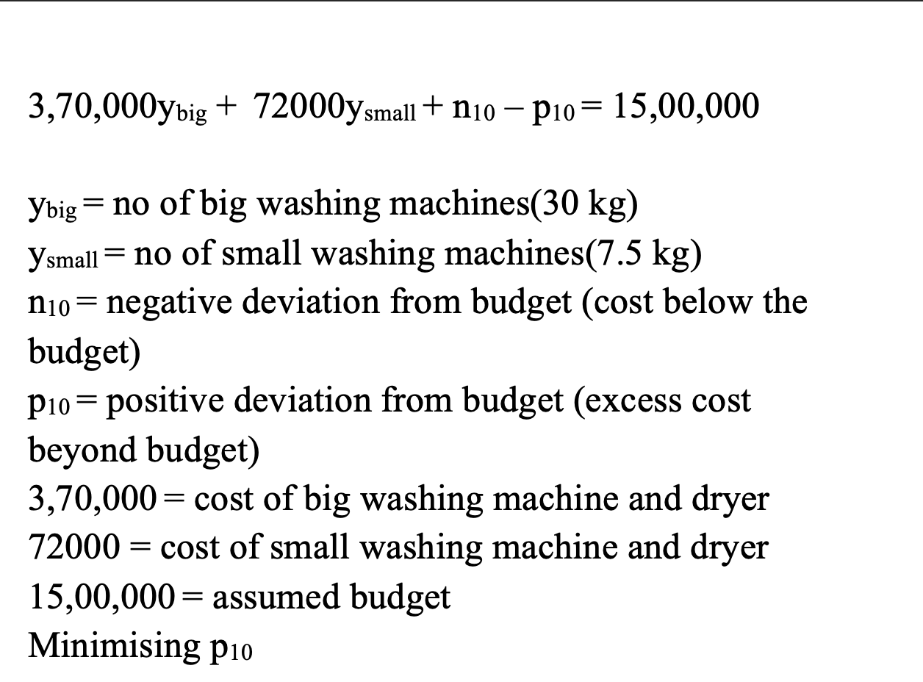
Home
Free Laundry
Paid Laundry
FLAME
Laundry
Cost Constraint

Slide 14
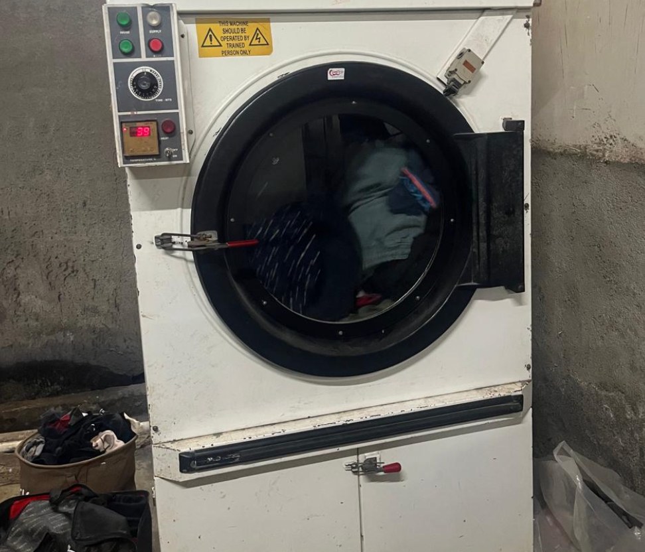
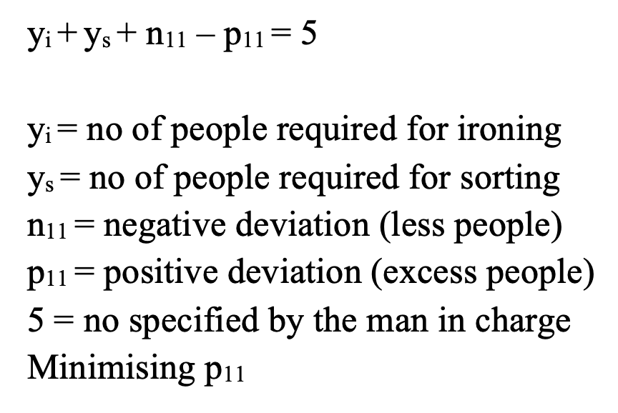
Home
Free Laundry
Paid Laundry
FLAME
Laundry
Meeting the demand
Constraint for People

Slide 15
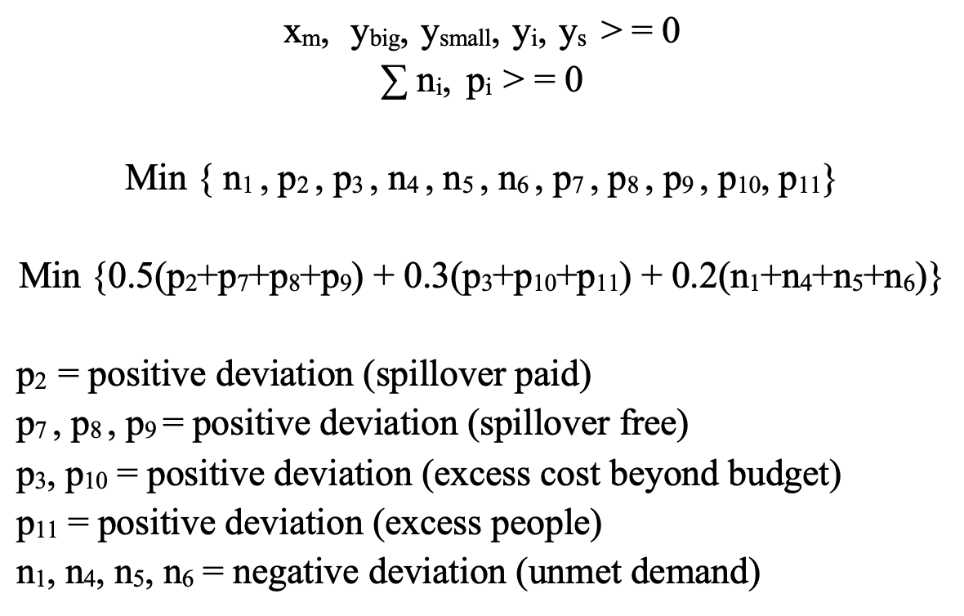
Home
Free Laundry
Paid Laundry
FLAME
Laundry
FINAL OBJECTIVE

Slide 16
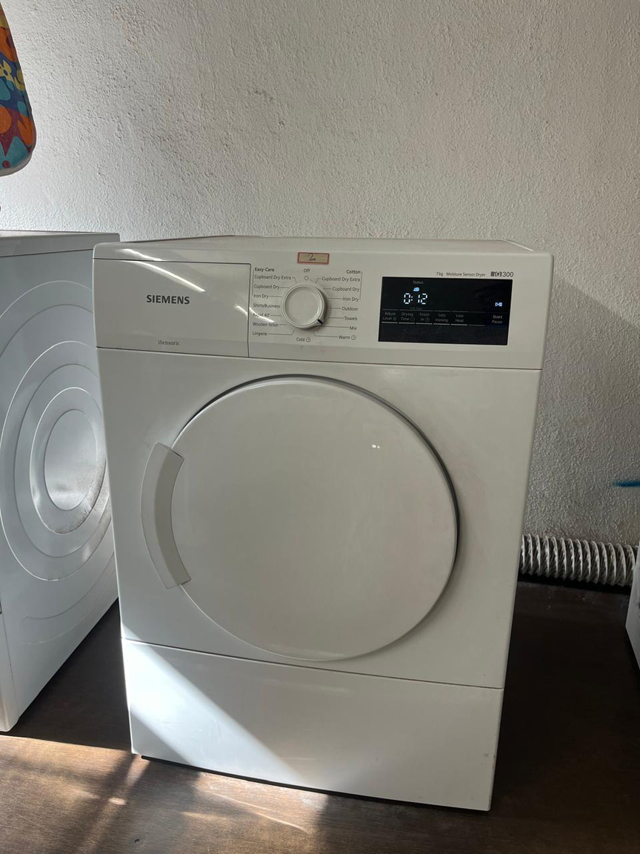
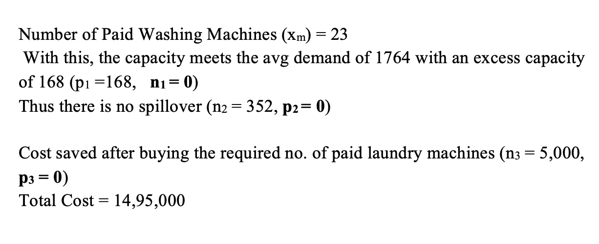
FLAME
Laundry
Home
Free Laundry
Paid Laundry
Solution after Formulation

Slide 17
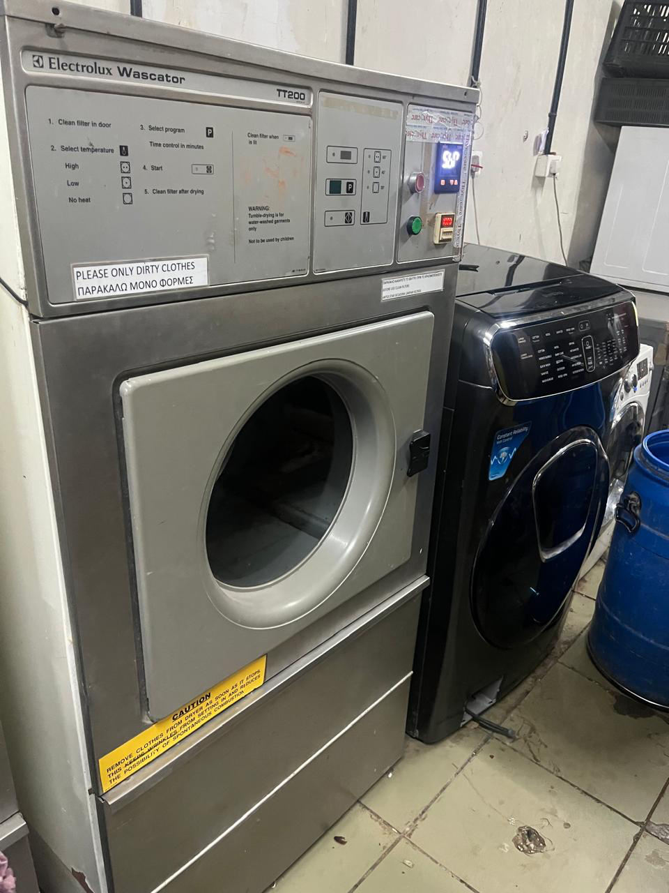
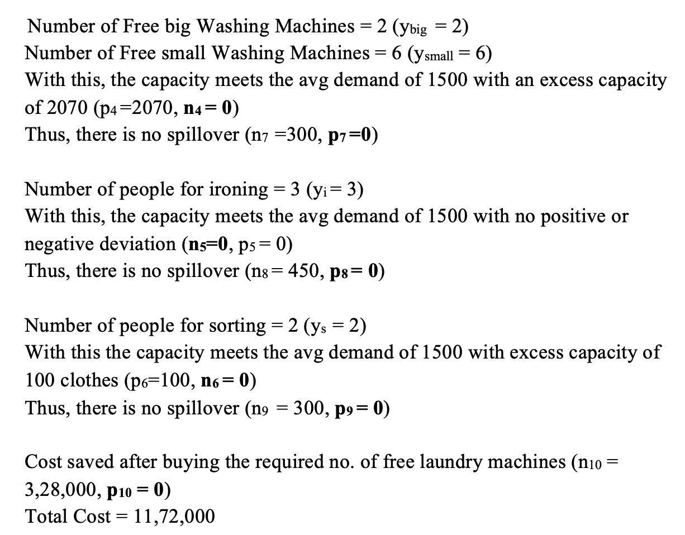
FLAME
Laundry
Home
Free Laundry
Paid Laundry
Solution after Formulation

Slide 18
FLAME
Laundry
Home
Free Laundry
Paid Laundry
Limitations/Drawbacks
Solver stops when it finds a Target cell value within the tolerance percentage of the theoretical optimal target cell value. Thus our solution is not fully optimal and serves more as a guideline.
There are other complexities to this issue that could not be added such as electricity costs, water costs, labour costs, labour breaks, machine efficiency, fluctuations based on holidays and academic schedule, and overtime hours. We assume that the workers and machines are working at full efficiency and that all tasks are happening simultaneously throughout the day.

Slide 19
FLAME
Laundry
Home
Free Laundry
Paid Laundry
Thank You

